Slide 1
IMDS Release 10.0
Modified AI Releasing Process
CLEPA Filderstadt
Peter Müller/ April 22, 2015

Slide 2
IMDS Release 10 – Enhancement Overview
MMDS = Material MDS
Enhancement | Description
* New Material Check: Additive Polymers | Disclosure of Polymer Additives and check for MMDS consisting 100% of only one substance
* Agreed Weight Tolerance: Standardized Deviation, Eliminate Tolerance | New default ranges all OEMs accept and warnings for exceeding
Perceived IMDS Confidentiality Concerns | Hide Supplier Name and Trade Name for MMDS from recipients and explanation about the Remark entry field
* Published MMDS Quality – Approval form for MMDS creators | ‘Self-certification’ granting publish rights for MMDS
* Published MMDS Quality – MMDS creation checks | Published MMDS must not have any Warnings
* Polymeric Parts Marking | Revise checks to more closely align with regulations
Development Sample Report Changes | Change wording to ‘Preliminary MDS’ and final MDS is required
Organizational search function | Revisions to org units areas on User Administration screens
* Biocide Product Regulation | Implement support for Biocide Product Regulation compliance ➔ Will be included into new concept “Chemistry Manager”
* Explained in detail on event, others listed in ppt

Slide 3
New Material Check: Additive Polymers
Issue: | Most materials should consist of more than one substance, yet it is possible to send materials as a single basic substance without specifying additives.
Solution: | The “Check Procedure” will return a warning if a new created MMDS with one of the classifications 5.X or 6.X consists at 100% of only one substance. This check will be performed for all MMDS: for new created materials and also for referenced materials.
Challenges: | Some substances legitimately do not contain additives. An FAQ will explain that there are some exceptions under which materials can consist of only 100% substance and that therefore MDS should not be rejected as a general rule.
Results: | Material quality will improve significantly as suppliers are reminded to provide additive information. Support for additional compliance (e.g. REACH) is improved.

Slide 4
Agreed Weight Tolerance: Standardized Deviation
Eliminate Tolerance
Issue: | The IMDS Recommendations definitions of Tolerance and Deviation have ambiguous and potentially confusing interpretations. OEMs may agree on acceptable values, yet receive MDSs which are accepted by one and unnecessarily rejected by another.
Solution: | Implement range-based default values for deviations: Tolerance will no longer be displayed in the web-application, including legacy data. Add warnings when Deviation exceeds default ranges.

Slide 5
Published MMDS Quality – Approval Form for MMDS Creators
Issue: | Published MMDSs do not comply to IMDS Recommendations. MMDS creators do not have the knowledge to create MMDSs that are correct.
Solution: | Introduce a formal self-certification “May publish” process and qualification. To obtain the “Publish” qualification, users must confirm reading, understanding and following the IMDS Recommendations. Controlled and confirmed annually by IMDS Company Administrators*. MMDS may only be published if user is self-certified and upon confirmation of one of their IMDS Company Administrators.
Challenges: | Companies and users need to gain awareness Self-certifications may occur although skill requirements are not fulfilled
Results: | Awareness that MMDSs must follow certain rules Improved published MMDS’ quality

Slide 6
Published MMDS Quality – MMDS Creation Checks
Issue: | The quality of published MMDSs needs to be improved.
Solution: | Published MMDSs need to be Error and Warning-free, i.e. a MMDS containing Warnings can’t be published. Searches for standards-based published MMDSs (e.g. IMDS Committee) remains the same. Searches for other published MMDSs will default to finding only error and warning free MMDSs (with capability to override for critical legacy MMDSs)
Challenges: | Need to monitor conflict situations where MMDS is correct but IMDS throws Warning message. These MMDSs still can be sent or proposed.
Results: | High quality published Material MDSs. Improved reliability of published MDSs.

Slide 7
Polymeric Parts Marking 1/2
Issue: | The existing Polymeric Parts Marking checks need to be reworked to support the relevant regulations.
Solution: | Weight calculation stays unchanged as is in IMDS 9.0 and before. The 25 g check will be removed The classifications 5.4 and 5.5.x will be added to the 100g check The classification 5.2 will be added to the 200g check
Challenges: | These revisions will generate new errors and warnings for MDSs which previously would not have generated check violations.
Results: | The checks will more closely conform to the regulations.

Slide 8
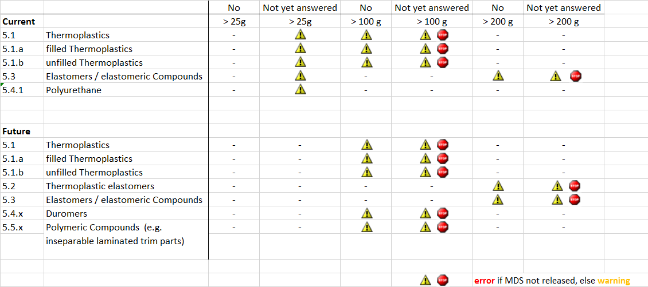
Polymeric Parts Marking 2/2

Slide 9
Biocide Regulations Enhancements
During analysis and design of this enhancement, we determined that requesting Biocide Product Information at the MMDS level would seriously impact the entire MDS flow throughout the supply chain.
A way to report Biocide information from MMDS creators through to OEMS without completely disrupting the existing MDS flow is necessary, so the initially planned Biocide regulation enhancements were halted.
A new approach, identified as the “IMDS Chemistry Manager”, is being explored to address aspects of Biocides (primarily), REACH, and other regulations.
The IMDS Steering Committee has appointed a working group to elaborate the specifications of the Chemistry Manager.
The current plan is to include the Chemistry Manager with IMDS Rel. 10, possibly after other enhancements are completed.

Slide 10
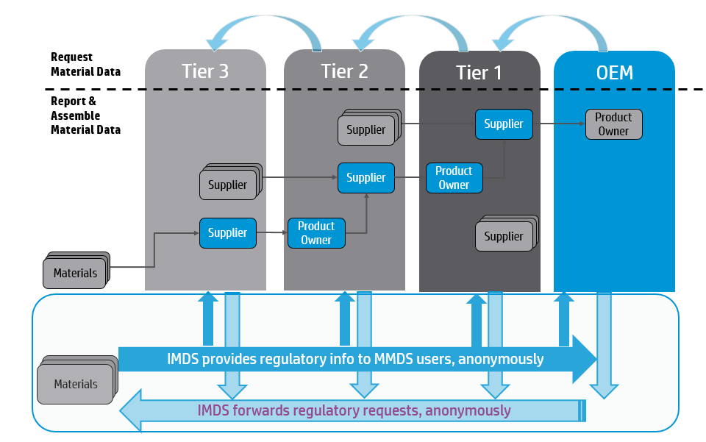
Chemistry Manager – Basic Principle
Looser coupling of material and regulatory reporting
MDS Exchange
Up to several weeks/months
Chemistry Manager
Minutes/hours for information exchange

Slide 11
Perceived IMDS Confidentiality Concerns
Issue: | IMDS supply chain entry masking has perceived gaps, so suppliers insufficiently familiar with which fields are exposed copy MMDSs to protect supplier’s identity, creating unnecessary MMDSs. The fields concerned are “Supplier Name”, “Trade name” and “Remark” and exist only for MMDSs.
Solution: | For MMDS “Supplier Name” and “Trade name” the existing IMDS supply chain confidentiality mechanism will be used to hide or disclose information: These fields shall be visible if you own, have received/accepted the MMDS or it is published. To the entry field “Remark” explanatory text will be added to indicate it remains visible, and to use caution to avoid entering confidential information.
Challenges: | Recipient companies which are used to this information always being accessible may object when these fields are not visible.
Results: | Users without training will know which fields are exposed. Users will better understand how IMDS protects proprietary data. Users perceived need to create copies will be resolved.

Slide 12
‘Development Sample Report’ Changes
Issue: | The wording “Development Sample Report” is confusing. Suppliers erroneously believe they should select this option when performing a sampling process.
Solution: | Change “Development Sample Report” to “Preliminary MDS”. Add Warning text next to the check box explaining “If you tick the box, this MDS will be a preliminary version. You will need to send later a final version.”
Challenges: | N/A
Results: | This will reduce the sending of final version MDSs as preliminary versions, saving time and effort throughout the supply chain.

Slide 13
Organization Search Function
Issue: | The Administration → User → Create New User screen does not provide search capability for Org Units during assignment.
Solution: | On the Administration → User → Create New User screen, provide the capability to search and specify Org Units for the newly-created user.
Challenges: | N/A
Results: | Assigning users to Org Units allows to search for specific Org Units. This is particularly helpful in case a company contains many Org Units.

Slide 14
IMDS 10.0 Release Process
All Business Designs for new enhancement have been approved by the IMDS SC Exception: BPR enhancements will be included in the new concept of Chemical Manager.
Chemistry Manager is in definition phase.
Implementation of enhancements are in process and may be ready for evaluation at end of June, 2015.
Communication about AI relevant implementations may start May, 2015.
IMDS 10.0, including Chemical Manager will be rolled out earliest during December 2015. The date is still fluid and subject to adjustment.

Slide 15
Modified Release Process for AI relevant Enhancements

Slide 16
Revised Rollout Process for AI-relevant IMDS Releases
General Communication next IMDS Release (Events, Newsletter, Release Notes)
Updated AI Specification
AI Release Specification
Release Notes
No more changes - exceptions to be decided by SC and HP
Feedback Industry Associations
1 Month Evaluation IMDS MOFNext
Stakeholder Feedback:
Change Requests impacting IMDS and/or AI during MOFNext period ?
3 Month IMDS MOFNext Period
IMDS Production
SC/HP decide about start of MOFNext period depending on change requests
P-4 Month
P-3 Month
P-2 Month
P-1 Month
P Production

Slide 17
Thank you
PeterKH.Mueller@hp.com
www.mdsystem.com
www.cdxsystem.com

