Slide 1
AIAG Update
B.B. Baney
April 2015

Slide 2
Agenda
AIAG Chemical Management & Reporting Overview (OHCL)
  Subgroups
  2014 activities
  2015 plans
AIAG Conflict Minerals Overview
  Subgroups
  Conflict Minerals Cross-Industry Benchmark Report
  Due Diligence Framework
  Smelter or Refiner (SOR) Engagement Process
  Smelter Engagement Teams
  2014 Company Survey on Reporting Challenges
  2015 plans

Slide 3



















AIAG Board Companies
Caterpillar
Dana
Delphi
Denso
Eaton
Federal Mogul
Fiat Chrysler
Ford
Freudenberg-NOK
General Motors
Honda
IBM
Infor
JCI
Magna
Nissan
Robert Bosch LLC
Specialty Products
Toyota
TRW Automotive

Slide 4
OHCL Subgroups &
2014 Activities
Recommendation and Documentation
  Main interface with IMDS Steering Committee on:
    IMDS Recommendations
    New IMDS business design input & testing
  New co-chairs
    Chris Harden, RJS
    Scott Morris, Honda
Supports REACH TF efforts
Supports AIAG Conflict Minerals Workgroup

Slide 5
OHCL 2014 Accomplishments
Interface with IMDS Steering Committee to maintain, improve reporting processes, tools and related customer feedback, while helping NA users
Rec & Doc subgroup evaluated, tested, and provided valuable support for IMDS 9.0 release
The Globally Harmonized System (GHS) project team progressed well
Held successful 2014 IMDS & Product Chemical Compliance Conference

Slide 6
OHCL Future Tasks & Focus
Support model office testing and feedback for IMDS 10.0 business design
Support Supplier Alliance activities
Understand and enhance awareness/communication of NA new regulations, timing, & impact
Enhance communications between members and other industrial organizations, e.g. CLEPA, REACH TF, JAMA, KAMA, JAPIA, ACEA

Slide 7
Conflict Minerals Subgroups –
Actions and Stakeholder Involvement
Industry Best Practice
Recommendations/drafts information to communicate common process for the industry
AIAG Smelter Engagement Team (SET)
CFSI Engagement
Due Diligence
Communications/Events
Creates/supports initiatives to develop tools & resources to assist companies in their reporting processes
Develops strategies for CMWG stakeholder outreach; identifies potential target audiences and communication opportunities(e.g., events, media, etc.)
Participates in key Conflict Free Sourcing Initiative (CFSI) groups to foster cross-industry engagement on smelter audit certifications and other conflict mineral reporting processes
Conducts research & outreach encouraging smelters to participate in CFSI
Notes:
Stakeholder engagement is a core element of the work group’s strategy.
This chart lists many of the activities in which we are currently engaged in or support.

Slide 8
Conflict Minerals Subgroups –
Actions and Stakeholder Involvement
iPCMP User Group
Minute-Takers
Captures CMWG meeting minutes and submits to AIAG for processing
Technical Information
Contributes industry expertise (materials composition, IMDS, etc.) for the enhancement of tools & resources
Training & Education
IPC Liaison
Conveys input on the cross-sector conflict minerals data exchange standard
Supports CMWG on-going efforts to create awareness of conflict minerals reporting, and the resources available to assist the supply chain
Focuses on due diligence data reporting activities from a user viewpoint
Notes:
Stakeholder engagement is a core element of the work group’s strategy.
This chart lists many of the activities in which we are currently engaged in or support.

Slide 9
Benchmark of Company SEC filings
This has been a cross industry effort
Benchmarking reports submitted between May 23, 2014 and June 2, 2014
Currently 307 submissions have been reviewed
The work continues on…
Raw data will be made available to IPC, Automotive Industry Action Group (AIAG), Association of Equipment Manufacturers (AEM), Aerospace Intl Assoc (AIA), CFSI, and the Cross Industry Group
*Very Important – the data is only meant for benchmarking and education
Notes:
Tetra Tech and several organizations conducted a cross industry effort to benchmark Conflict Minerals Reports submitted to the SEC for the period May 23, 2014 and June 2, 2014 . Approx 1,300 submitted, will 1,179 out of them. EOY or 2015. giving raw data to organizations—inclusive. SRZ. ELM group. EY benchmark F500.
Participating associations on this Cross-Industry Work Group include:
IPC, AIAG, Assoc of Equipment Manufacturers (AEM), and Aerospace Intl Assoc (AIA) and the Conflict Free Sourcing Initiative (CFSI)
Today, I will share with you key observations from the Cross-Industry Group’s preliminary report
A copy of this entire preliminary report is available on the Conflict Minerals page of AIAG.org; the full report will be available by year end 2014.

Slide 10
Industries
4% | Aerospace
2% | Apparel
7% | Automotive
8% | Chemical
2% | Component Manufacturer
7% | Consumer Products
39% | Electronics
3% | Food & Beverage
4% | Large Equipment
3% | Material Manufacturer
4% | Medical Devices
8% | Retail
10% | Various
Notes:
Note the diversity of the industries benchmarked
Thus far, 307 submissions from filing companies have been reviewed by the Cross-Industry Work Group

Slide 11
CFSI CMRT (formerly EICC/GeSI Template)
Of the 19% that did not use the CMRT, 7% used a company internal survey and 93% did not state a resource
Software
Of the 307, 14% identified a software solution, 86% did not identify software
Notes:
Now let’s turn our attention to the tools companies are using to gather data, if any
This slide focuses on the 307 submissions from filing companies and their utilization of the CMRT and software solutions,
Data shows most companies benchmarked did use the Conflict Minerals Report Template (formerly the EICC/GeSI Template)
Of those that did not use the CMRT, a small percentage use an internal resource
However, most did not elaborate
We also see that 14% of the 307 CMRs benchmarked reported they used a software solution, while most did not indicate is a software was used

Slide 12
Country of Origin Data
0.33% of companies provided names of the mines
5.54% of companies listed the country of origin
Notes:
Here we see the preliminary results of those that did reference the Country of Origin
Recent reports and allegations of sources originating from sanctioned countries has prompted the attention of U.S governmental agencies such as the Department of Treasury’s Office of Foreign Assets Control or (OFAC).

Slide 13

Due Diligence Framework Prescribes Role of Filing Companies
SEC Final Rule for Conflict Minerals
3TG (Tin, Tungsten, Tantalum, Gold)
Organization for Economic Cooperation and Development (OECD)
Due Diligence Guidance for Responsible Supply Chains of Minerals
From Conflict-Affected High-Risk Areas
1
2
3
4
5
Establish Strong Company Management Systems
Identify And Assess Risk In The Supply Chain
Design And Implement A Strategy To Respond To Identified Risks
Carry Out Independent Third-party Audit Of Smelter or Refiner (SOR) Due Diligence
Report Out On Supply Chain Due Diligence
Notes:
Step 4 of the OECD Due Diligence Guidance mandates that 3rd party audits are conducted at strategic points within the supply chain = SMELTERs or REFINERs
The guidance encourages industry to develop a collaborative approach to achieving this. The CFSI Conflict Free Smelter Program is the collaborative effort.
And AIAG is a member and has engaged in the effort to engage smelters……..

Slide 14


Steps to Identify Potential Audit Candidates
200+ Companies
CFSI - 30 Companies
AIAG - 10 Companies
CFSI Staff & 5 Companies
~ 10 Companies
3rd Party Audit
CFSI Members
Gain access to CFSI Smelter Data
Participate in various work groups
Pay Membership Fee
Smelter Engagement Team (SET)
Confirm Probable Smelters - verify smelter product
Outreach –encourage audit participation
Smelter Disposition Team
Experts make final determination of true smelters
Pre-Audit Visit Team
Explain CFSI program, audit expectations and benefits
e.g. Apple, Intel: > 35 international visits/year
3rd Party Auditor
Conduct site audit, create audit report for review by CFSI Audit Review Committee (ARC)
Notes:
SOR – Smelters or Refiners
SET – Smelter Engagement Team
AIAG is committed to engaging smelters to participate in the CFSI conflict free smelter program
They have a team of conflict minerals workgroup members that are working together on the smelter engagement project

Slide 15

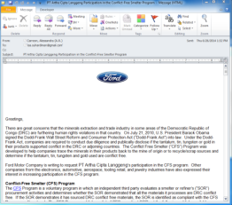
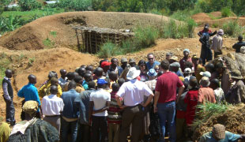
AIAG SET Activities
CFSI Activity:
Two Main Areas of Focus for AIAG SET team:
Research
Probable Smelter Confirmation
Outreach
Purpose: Disposition alleged smelters as probable or not a smelter
Purpose: Confirm probable smelters in order to include in standard smelter list
Purpose: Encourage known smelters to participate in Conflict Free Audit & become Conflict Free certified
On-line research, calls, emails
Letters, calls
Letters, calls, visits
Notes:
The smelter engagement team is working to confirm smelters that have previously been dispositioned as “probable” to determine if they are legitimate smelters and to encourage those that are to participate in the conflict free smelter program

Slide 16
Impact of CFSI & AIAG SET efforts
Active and Compliant Smelters / Total Legitimate Smelters*
Metal | September ‘14 | December ‘14 | January ‘15 | February ‘15 | March ‘15
Tantalum | 95% (35/38) | 96% (44/46) | 96% (44/46) | 98% (45/46) | 98% (45/46)
Tin | 58% (44/75) | 57% (50/87) | 62% (54/87) | 64% (56/88) | 64% (57/89)
Tungsten | 37% (12/33) | 40% (17/42) | 48% (20/42) | 49% (21/43) | 54% (23/43)
Gold | 50% (55/111) | 57% (68/119) | 57% (68/119) | 56% (67/119) | 60% (72/119)
TOTAL | 57% (147/257) | 61% (178/294) | 63% (186/294) | 64% (189/296) | 66% (197/297)
50 additional compliant smelters in 5 months
*As published by CFSI
Notes:
Together, CFSI and the AIAG SET group have made significant progress in increasing the number of confirmed conflict free smelters in just a short period of time. Both groups are continuing to expand in size and increase their efforts to encourage known smelters to participate in the conflict free audit process.

Slide 17









AIAG Smelter Engagement Team
&
collaborate towards a common set of goals

Slide 18
  2014 Company Survey on Reporting Challenges
Sub-Tier Supplier Survey conducted in July-August, 2014 to better understand challenges of conflict minerals reporting and to inform CMWG’s 2015-2016 strategy
29-question survey developed by the CMBP subgroup
Request distributed to AIAG, OESA, & request to distribute down
Received responses from 466 suppliers
Survey data was analyzed in a partnership with Grand Valley State University Statistical Consulting Center.

Slide 19
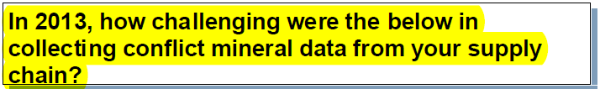
  2014 Company Survey on Reporting Challenges
Questions include:
Example Hypothesis: Greater management support decreases challenge in collecting conflict minerals data from suppliers
  Conclusion: Complete management support was associated with significantly fewer challenges in data collection
  Interesting note: No management feedback fared better than poor management support (though neither did well)
More results available after AIAG CR Summit 4/29/15

Slide 20
Looking Forward 2015
    Demonstrate continued improvement year over year
    Improve smelter information accuracy and completeness
    Consider obtaining assurances around your supply chain process
    2015 data gathering will be similar to 2014
      CMRT 4.0 from CFSI will look very similar to 3.02a
      Timing of requests/responses will be similar to 2014
Notes:
Consider how this may link to your overall Foreign Corrupt Practices Act (FCPA).

Slide 21
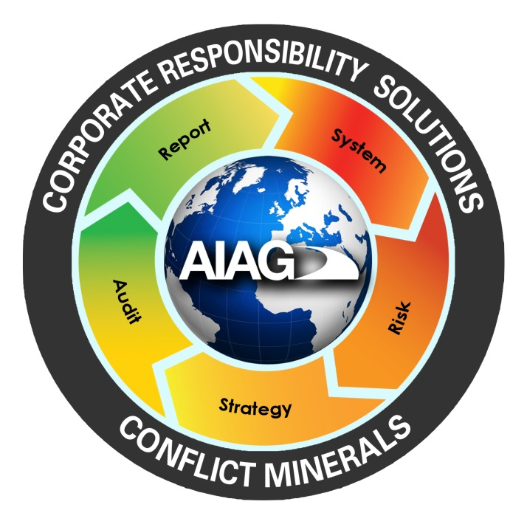
Future Questions
Workgroups latest public information & resources are available at www.aiag.org/conflictminerals
Questions may be directed to Tanya Bolden at conflictminerals@aiag.org

