Slide 1
Dr. Karin Oldenburg-Nazaruk, BMW AG
Global List of automotive Process substances - GLAPS.
CLEPA Materials Regulations Event, 22nd April 2015

Slide 2
GLAPS – Global List of automotive process substances.
Aims of the project
Ideas for the content of the list
The GLAPS project

Slide 3
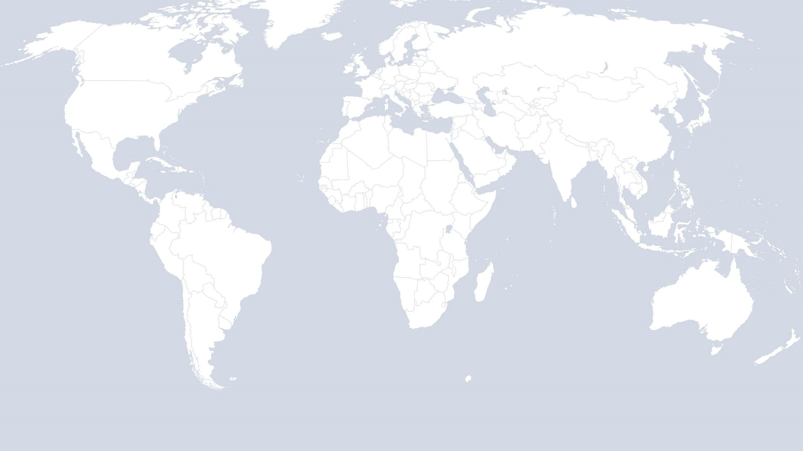
GLAPS – Global List of automotive process substances.
Do you or your customers have plants in other regions of the world?
§ ?
X
X
§ ?
§ ?
X
§ ?
X
§ ?
X
§ ?
X
§ ?
X
§ ?
X
§ ?
X
Do you have an overview about the legal requirements that have to be reflected?

Slide 4
GLAPS – Global List of automotive process substances.
HOW WE GOT HERE …
2013 – ACEA WG Materials and Substances proposed the idea of a harmonized list for an automotive process chemicals like GADSL for parts
2014 – contact to chemical industry without having a real concept
– ACEA internal survey on needs and visions
– ACEA Workshop held at Brussels for first project definitions
2015
– Invitation of other associations to join the project – Common development of a project charter

Slide 5
GLAPS – Global List of automotive process substances.
Project Leader: Dr. Brigitte Stein-Schaller, BMW AG
The interims project name „GAPSL“ was changed:
GLAPS [dʒiː læps]:
Global List of Automotive Process Substances

Slide 6
GLAPS – Global List of automotive process substances.
Aims of the project
Ideas for the content of the list
The GLAPS project

Slide 7
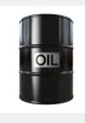
GLAPS – Global List of automotive process substances.
SUBTANCES ON THEIR OWN OR IN MIXTURES USED IN E.G…
Used in the vehicle → e.g. gear oil, paints
Used in production processes / maintenance (i.e. not ending up in the vehicle) → e.g. Chain grease
Chemical products with no production relevance (e.g. water treatment, toilet cleaners, floor polish, building paint)
Aftermarket chemical products
Packaging, when present in chemical products (e.g. oil coatings on parts, anti-corrosion atmosphere bags)
Specified substances that have exposure risk, to be listed in a restriction

Slide 8
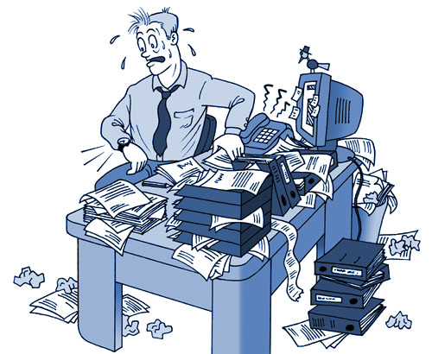
GLAPS – Global List of automotive process substances.
GLAPS - a new burden for the suppliers?
THE LIST IS INTENDED TO HELP THE AI TO …
Harmonise customer requirements
Realise efficiencies in the automotive industry (incl. supply chain)
Avoid duplication of substance regulatory monitoring work across companies
Protect human health and the environment
Ensure process stability in production plants
Made available to the supply chain for their own optional use

Slide 9
GLAPS – Global List of automotive process substances.
THE LIST SHOULD …
Track and anticipate regulations applicable to process use of substances in any region
Be based on the “worst case” in any region
Distinguish between professional use and consumer use
Indicate reason(s) for listing and region(s) directly affected
Participating member companies may choose to apply the list globally or according to regions directly affected
Be established and managed separately from GADSL (but may be presented in a similar format)

Slide 10
GLAPS – Global List of automotive process substances.
CRITERIA FOR LISTING A SUBSTANCE SHOULD INCLUDE …
Worldwide State/National/Regional Regulation
GHS as applied in different regions/countries
REACH-like regulations worldwide (e.g. EU, China, Korea, etc)
National/regional chemical inventory status
Conditions of use for the substance

Slide 11
GLAPS – Global List of automotive process substances.
NOT CONSIDERED IN THE CURRENT PROJECT …
Specified methods for collecting supplier SDSs or substance compositions → But note the existing ACEA/JAMA/KAMA/CLEPA position paper on the long term intention for electronic SDS transfer via XML format
Common tool for collecting process substance and SDS data
Gaining a full overview of all process substances used in the automotive supply chain
Supplier declaration of conformity with REACH

Slide 12
GLAPS – Global List of automotive process substances.
Aims of the project
Ideas for the content of the list
The GLAPS project

Slide 13
GLAPS – Global List of automotive process substances.
MEMBERS
Volunteer members from America, Japan, Europe are joining the team
PROJECT DELIVERABLES
Publication of initial List;
Guideline for use of the List;
Charter for ongoing management of the List.
TIMELINE
Project start: March 2015
Project end: open (tdb by project team)

Slide 14
GLAPS – Global List of automotive process substances.
Aims of the project:
Thank you for your attention.
Your questions?

