Slide 1
IMDS data use
CLEPA Materials Regulations Event
(2015-04-22)
Presented by
Sylvia Aßmann
Dr. Stefan Dully
On behalf of Supplier Alliance (SUAL)

Slide 2
Agenda
Background
Preconditions
Approach
Adopt IMDS – User relationship
Adopt Sender – Recipient relationship
Adopt License Model
Status & next steps
1
2
3

Slide 3
Background
IMDS is the established & leading system for material data reporting, and is used along the whole automotive supply chain worldwide
Suppliers from the beginning agreed on and strongly supported data collection, standardization and data quality – and still do so
Reporting requirements with same purpose coming from other industries & other regions are increasing
All global players have to act in an efficient way – and focus on improvement of products, documentation & compliance
Extended use of existing IMDS data becomes inevitable

Slide 4
Preconditions for Data Use
in-scope is the "re"-use of existing IMDS data for Inhouse systems of AI users
Not in scope is a direct interface between IMDS and any other system
Suppliers individually take measures to protect their own and their suppliers know how and confidential business information

Slide 5
Adopt IMDS – User relationship
1
Add criteria to the ToU (to be agreed on between suppliers and IMDS SC)
it is ensured that requirement on data usage are kept (no cost analyses, e.g. for content of substances, only for environmental issues, … )
no data access for third parties
only recipients defined by sender have access to the data, no publication of the data outside the systems (b2b or authorities)
No systematic analysis of data by third party
No disclosure of supply chain
Usage only for compliance issues (including substance / material evaluation for LCA without relation to suppliers or costs)
No unauthorized transfer of data from third-party system to other systems (no forwarding)
Target system vice versa has to allow data transfer to IMDS
system has to fulfill IT security standards (e.g. encrypted communication, user profiles)

Slide 6
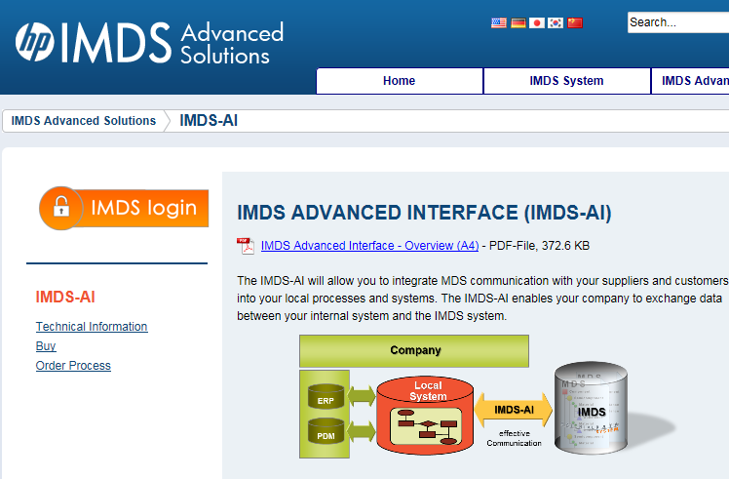
Adopt Sender – Recipient relationship
2
Individual agreements in supplier contracts
3
License model
To be suggested by HP

Slide 7
Status & next steps
SUAL to
Check and comment on IMDS SC proposals as listed in
Get approval of the suppliers associations
SUAL and IMDS SC to agree on, including legal advisory groups of both sides
HP to provide suggestion for new license model
Target date: End of May 2015
1
1
3

Slide 8
Thank you!
Your questions?
Your comments?

